Slide 1
Tăt și vrei
Cătălin Pleșu

Slide 2
Painters
LEONARDO DA VINCI
MICHELANGELO
REMBRANDT
VINCENT VAN GOGH
PABLO PICASSO
MARY CASSATT
Katsushika Hokusai

Slide 3
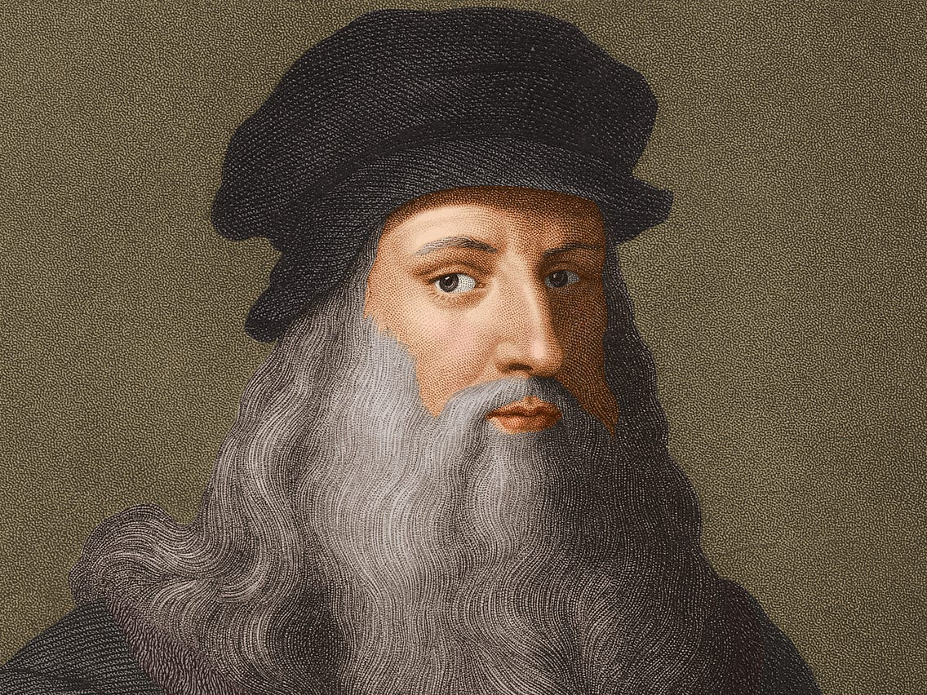
LEONARDO DA VINCI
He received little formal education
He was an illegitimate child
He was a chronic procrastinator
He was charged with sodomy

Slide 4
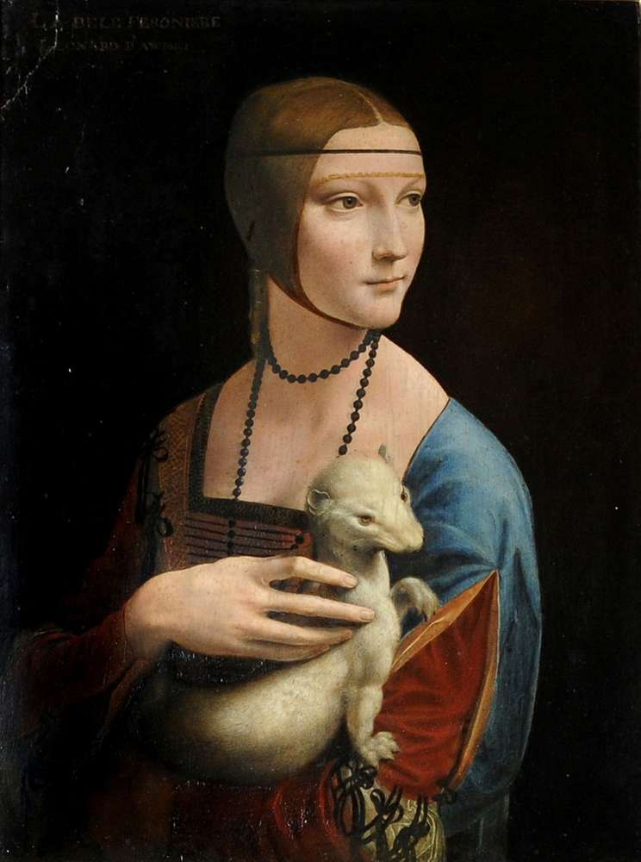
Lady with an Ermine

Slide 5
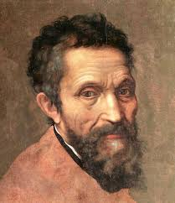
MICHELANGELO
He completed artworks for nine different Catholic Popes.
He inserted his own likeness into some of his most famous works.
He designed military fortifications for the city of Florence.
He kept working until the week he died.

Slide 6
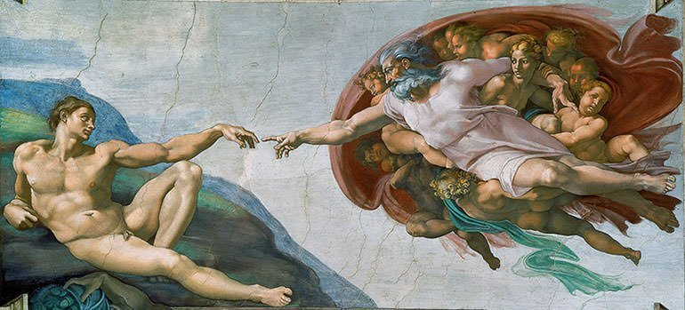
The Creation of Adam

Slide 7
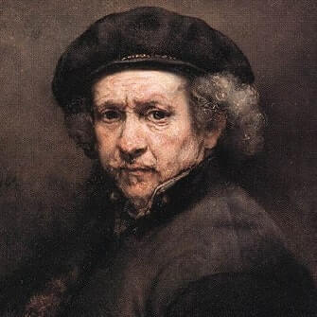
REMBRANDT
HE OUTLIVED FOUR OF HIS FIVE CHILDREN.
WE’RE NOT CERTAIN IF SOME OF HIS PAINTINGS WERE REALLY HIS.
HE NEVER LEFT THE NETHERLANDS.
IF YOU LOOK CLOSELY, YOU MIGHT RANDOMLY SPOT HIM.

Slide 8
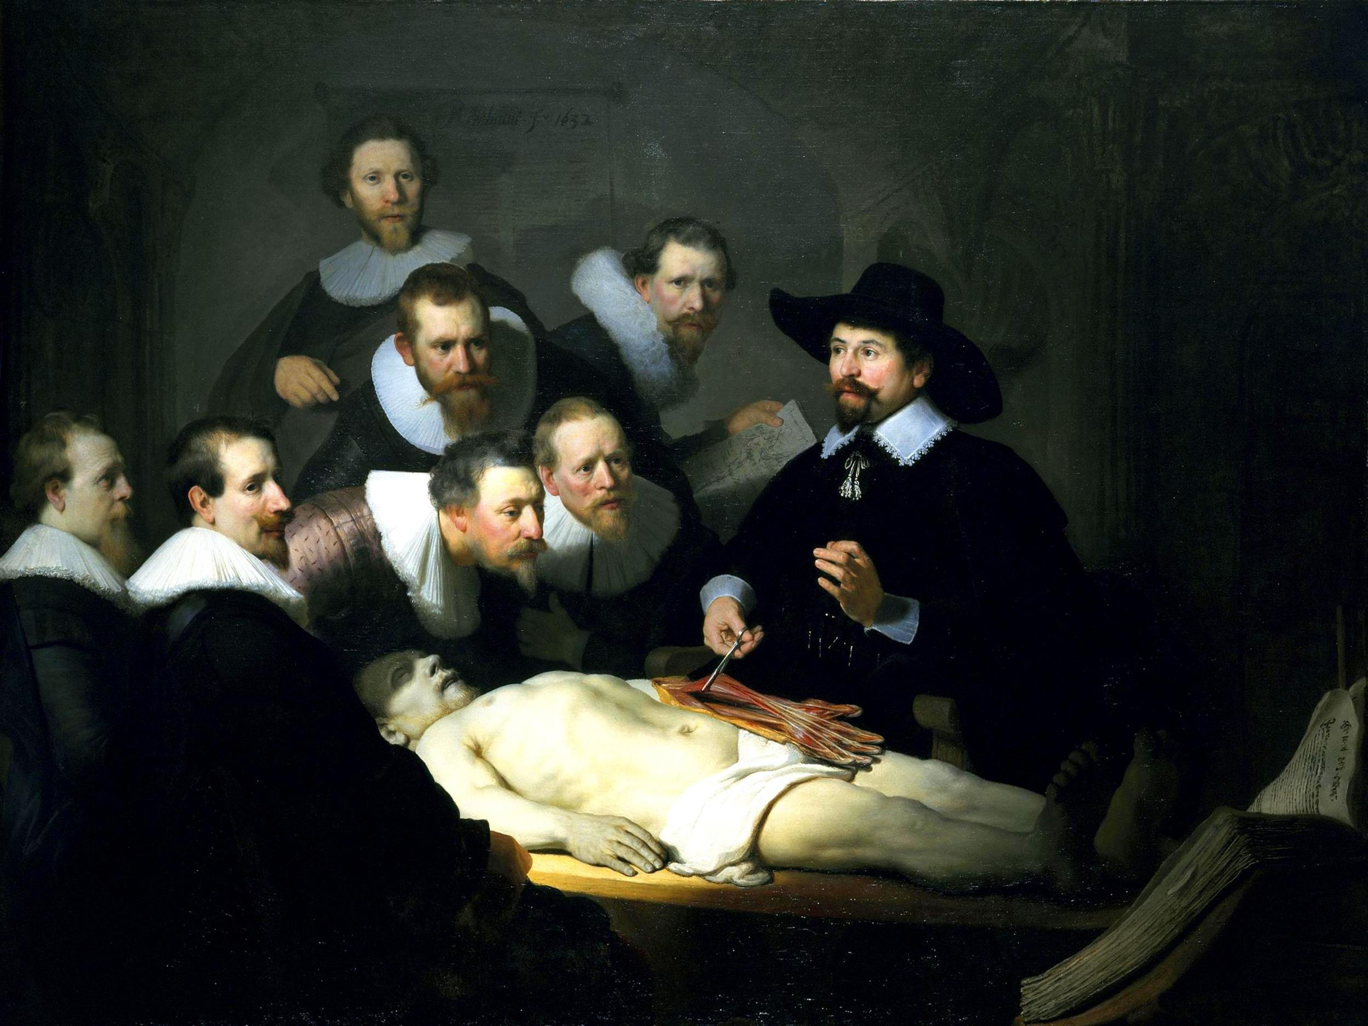
The Anatomy Lesson of Dr Nicolaes Tulp

Slide 9
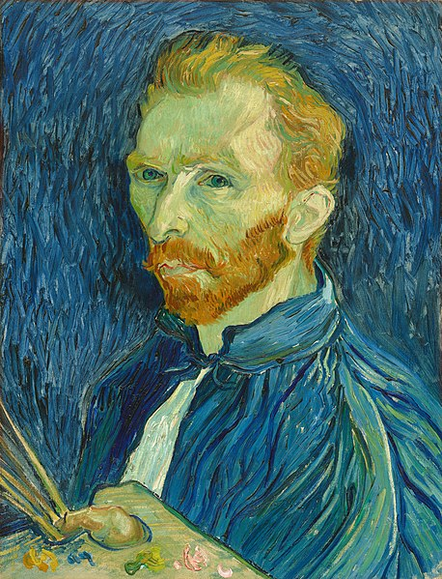
VINCENT VAN GOGH
He painted almost 900 paintings in 10 years
van Gogh lived with mental illness throughout his life
van Gogh spent his adult life in poverty
He was nicknamed ‘The Redheaded Madman’

Slide 10
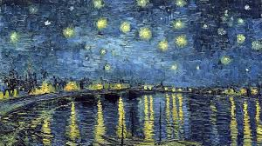

Slide 11
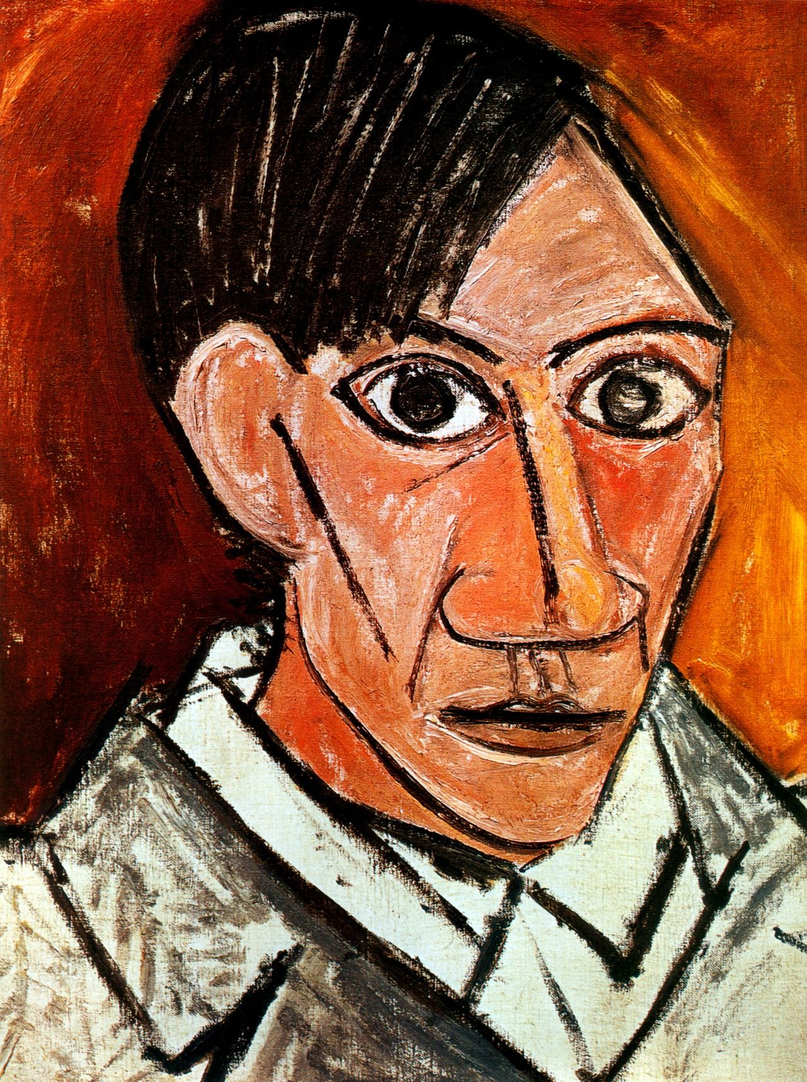
PABLO PICASSO
His full name is 23 words long
The Midwife thought he was stillborn
Picasso completed his first painting at the age of 9
He was a terrible student

Slide 12
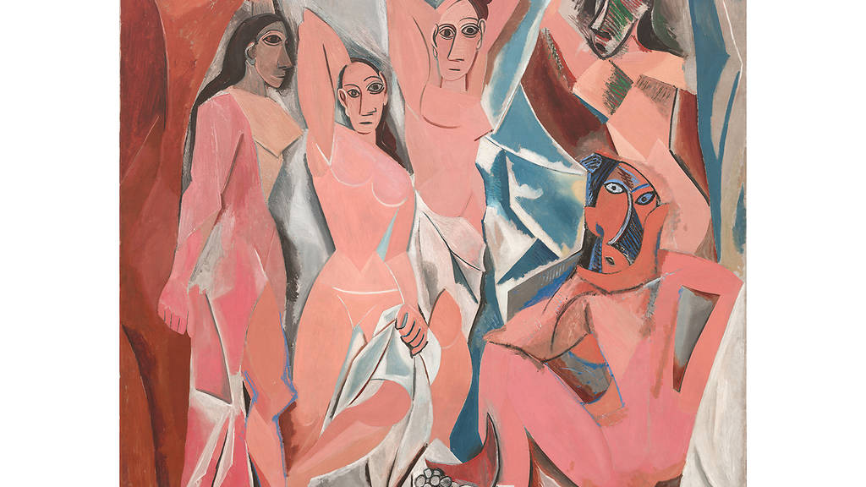
Les Demoiselles d’Avignon

Slide 13
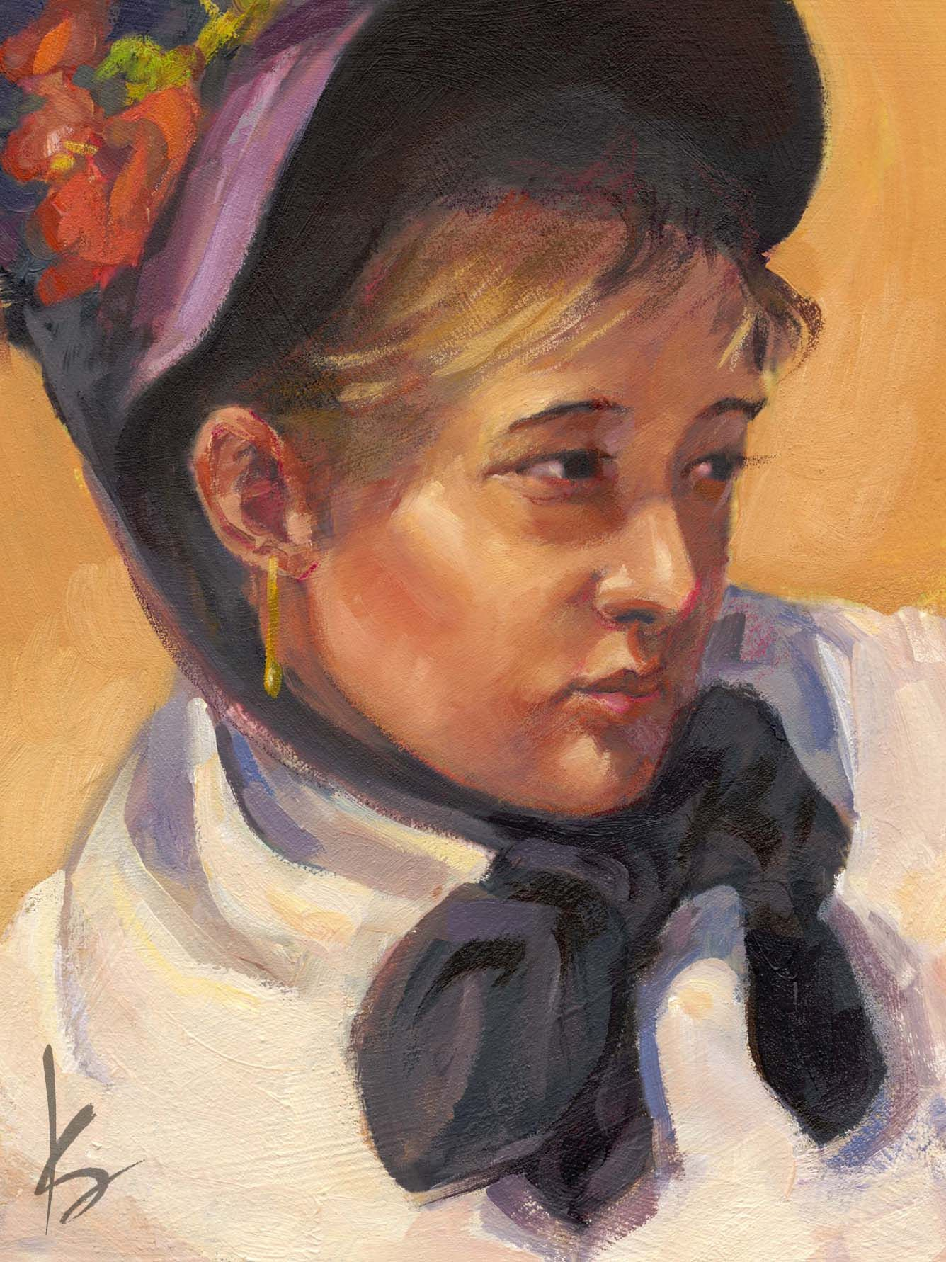
MARY CASSATT
As a young girl, Mary Cassatt developed her love of painting as her family traveled around Europe.
When Mary Cassatt was a young adult, she enrolled in the Pennsylvania Academy of the Fine Arts.
In 1871, Mary Cassatt was hired to make a commission that got her back on her feet.
In 1904, Mary Cassatt was awarded the Legion d'honneur for her artistic skills.

Slide 14
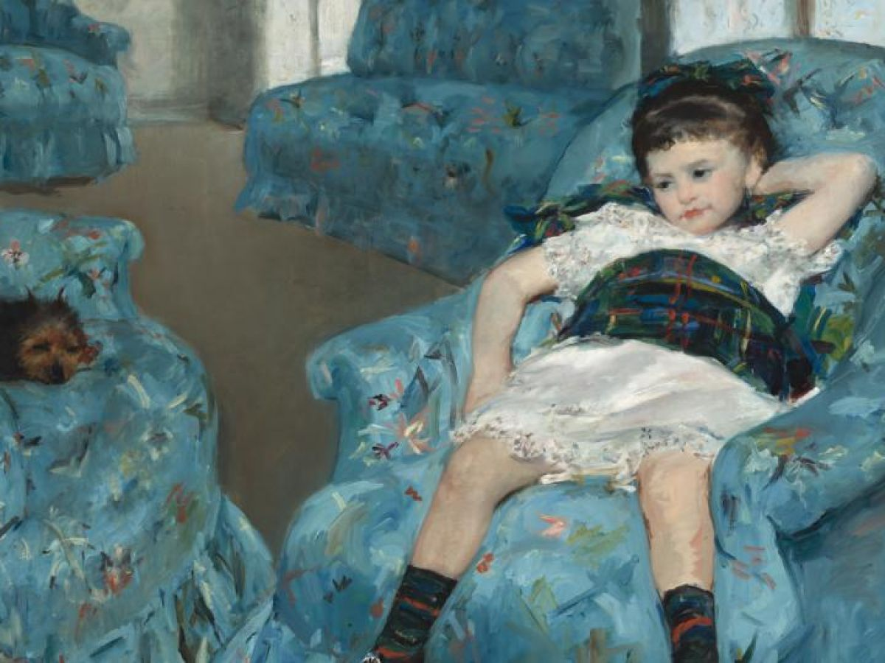
Little Girl in a Blue Armchair

Slide 15
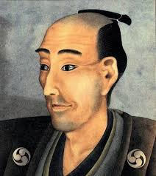
Katsushika Hokusai
He was one of the first users of the term “manga”
He produced 30,000 pieces of work
Hokusai also created erotic art, called shunga in Japanese. ”The Dream of the Fisherman's Wife”
Hokusai had a long career, but he produced most of his important work after age 60.

Slide 16
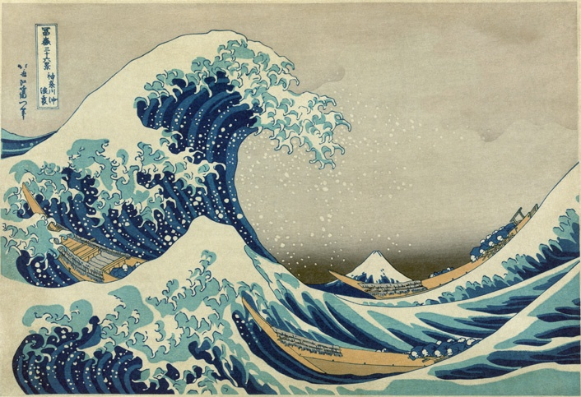
The Great Wave of Kanagawa

Slide 17
Billie Eilish
Billie Eilish Pirate Baird O'Connell ( born December 18, 2001) is an American singer-songwriter. She first gained attention in 2015 when she uploaded the song "Ocean Eyes" to SoundCloud, which was subsequently released by the Interscope Records subsidiary Darkroom.
Eilish's debut studio album, When We All Fall Asleep, Where Do We Go? (2019), debuted atop the Billboard 200 and became the best-performing album of 2019 in the US.
Her accolades include five Grammy Awards, two American Music Awards, two Guinness World Records, three MTV Video Music Awards, and one Brit Award. She is the youngest person and second person ever to win the four main Grammy categories – Best New Artist, Record of the Year, Song of the Year and Album of the Year – in the same year.

Slide 18
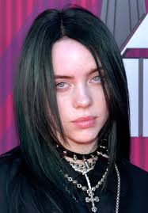
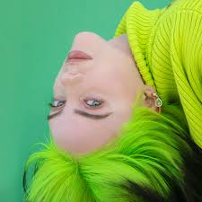
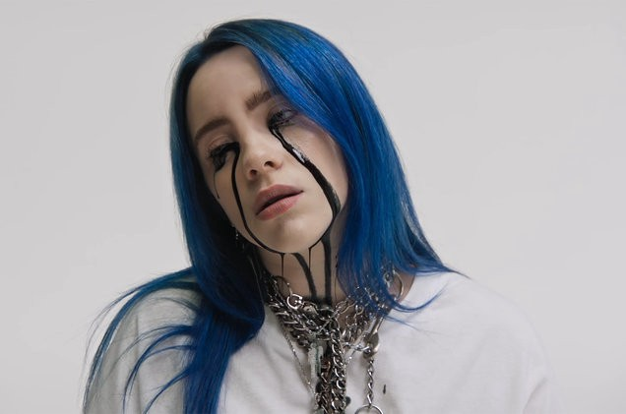
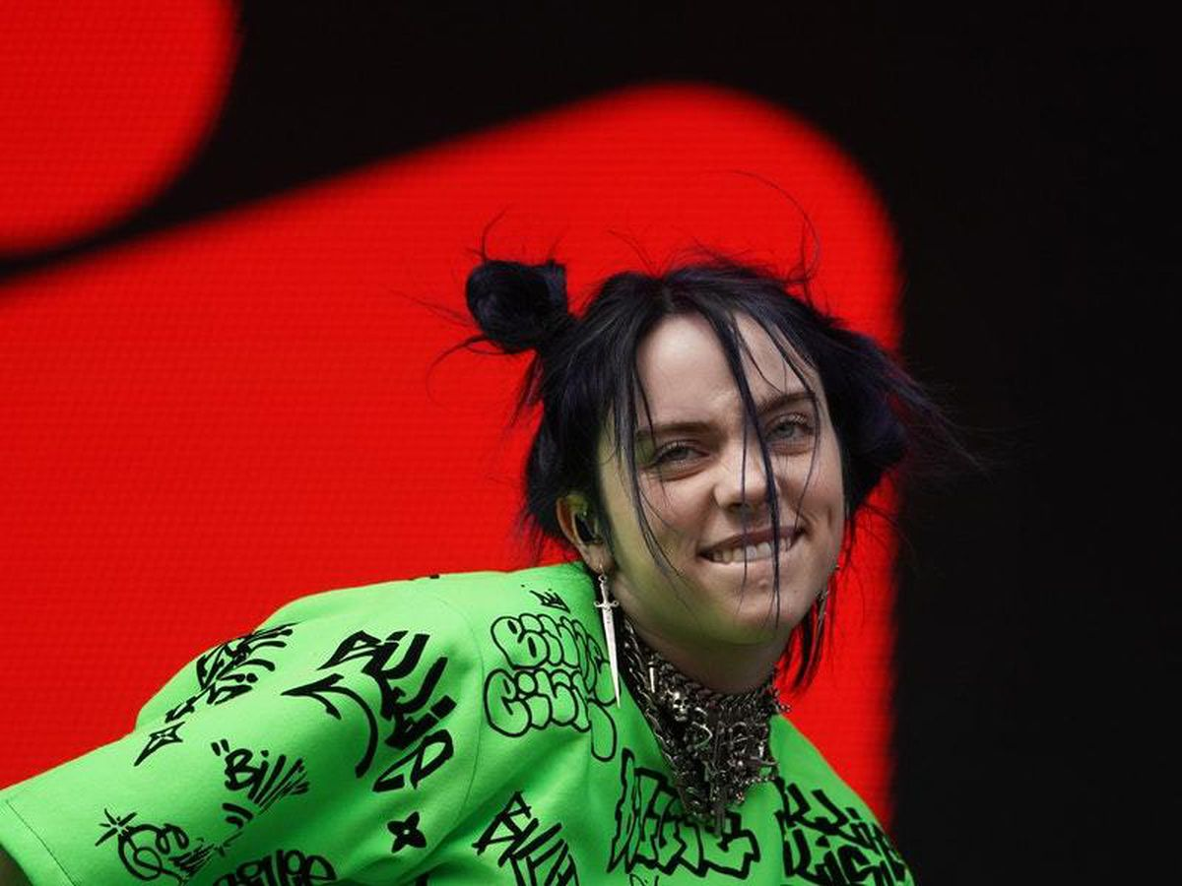
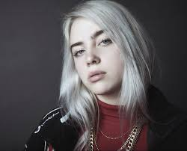
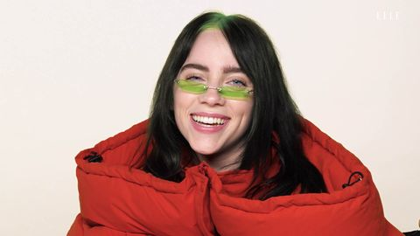

Slide 19
George Raymond Richard Martin
George Raymond Richard Martin, is an American novelist and short story writer, screenwriter, and television producer. He writes the series of epic fantasy novels A Song of Ice and Fire, which was adapted into the HBO series Game of Thrones (2011–2019).
AS A KID, HE MADE MONEY SELLING MONSTER STORIES.
HE IS OBSESSED WITH COMIC BOOKS.
HE BUILT A LIBRARY TOWER IN SANTA FE.
HE OWNS AN INDEPENDENT MOVIE THEATER.
MARTIN THINKS IT'S IMPORTANT FOR WRITERS TO BREAK THE RULES.
HE’S A SKILLED CHESS PLAYER.
HE HAS A VERY SPECIFIC WAY OF WRITING, WHICH IS WHY HE HASN'T FINISHED THE WINDS OF WINTER.

Slide 20
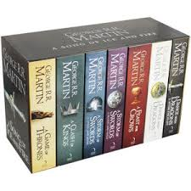
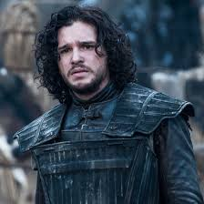

Slide 21
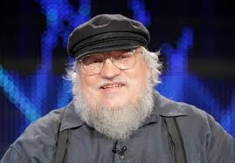
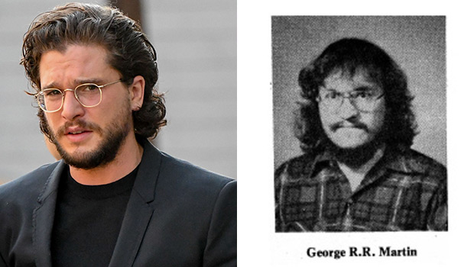

Slide 22
New Words
Shunga - erotic art in japonese.
Acolades – award or recognition.
Stillborn – born dead.
Sodomy – being gay.
Ermine – an animal that looks like a rat.

